Slide 1
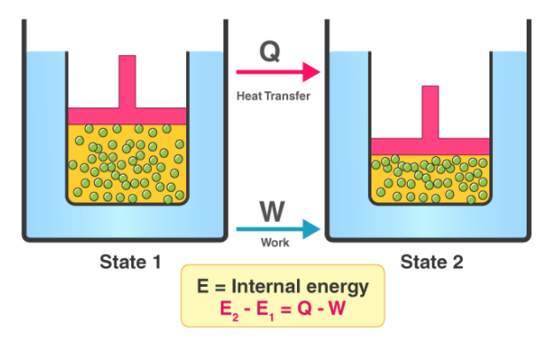
Chemical Engineering Thermodynamics Lecture 1 The First Law Xiaofei Xu

Slide 2
Class Schedules
Even Wednesday: 5,6 class; 1:30 to 3:10 PM
Every Friday: 3, 4 class; 9:55 to 11:35 AM

Slide 3
Textbook and References
Introduction to Chemical Engineering Thermodynamics, 8th edition, by J. M. Smith, etc, Mc Graw Hill Education press
化工热力学导论，英文改编版，化学工业出版社

Slide 4
Grading Rules
Final Exam: 70%
Mid Exam: 10%
Homework and Attendance: 20%

Slide 5
Outlines and Structure
chapter 1 and 2: introduction
chapter 3: PVT behavior
1st law
Enthalpy
Heat capacity
EOS
Sensible/latent heat
Carnot engines
2nd law
Entropy
3rd law
Ideal/lost work
Residual properties
Fugacity
Phase equilibrium
Excess properties
Equilibrium constant
chapter 5: the second law
chapter 6: thermodynamic properties
1 component
chapter 7: flow process
Mid term
chapter 8, 9: power production
and refrigeration
chapter 10: solution thermodynamics
mixture
chapter 11: mixing processes
chapter 12,13,15: phase equilibrium
chapter 14: chemical reaction

Slide 6
Lecture Schedule
Lecture 1: chapter 1 and 2
Lecture 2: chapter 3
Lecture 3: chapter 4 and 5
Lecture 4: chapter 4 and 5
Lecture 5: chapter 6
Lecture 6: chapter 6
Lecture 7: chapter 7
Lecture 8: chapter 8
Lecture 9: chapter 9
….

Slide 7
Thermodynamics History
3rd law, 1848, 1906
Gibbs free energy, enthalpy, 1876
1968, Quantum Thermo.
1941 Noneq. Thermo.
Boltzmann entropy, 1875
1940s Ch. E. Thermo.
2nd law, 1865
1905, Brownian motion
entropy, 1850
1871, statistical thermodynamics
1843, experiment on mechanical equivalent of heat
1824, Carnot’s circle and theorem
1750s, the Caloric theory

Slide 8
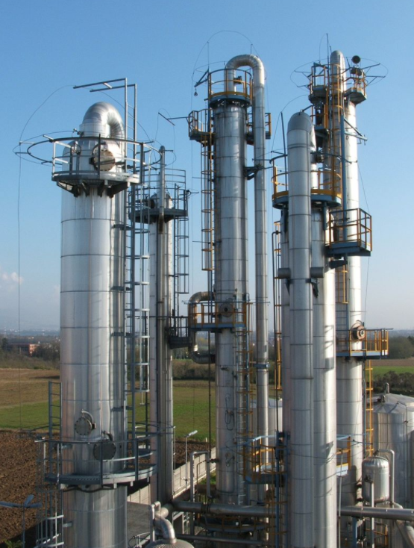
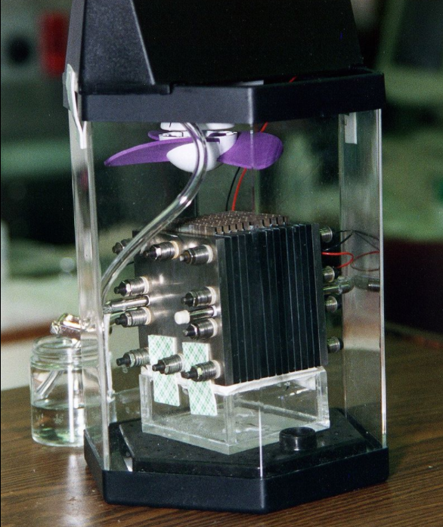
Thermodynamics
Thermodynamics
deals with heat, work, and temperature and their relation to energy, radiation, and properties of matter.
Chemical engineering thermodynamics
present Thermodynamics from a chemical engineering perspective; most likely to be encountered by chemical engineers

Slide 9
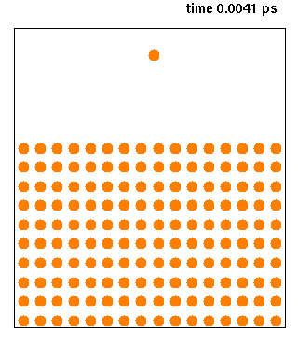
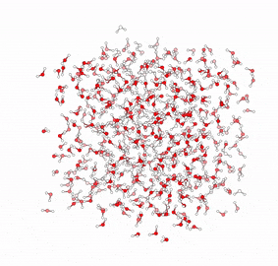
Thermodynamics in micro/nano scale
铜原子的沉积
水分子的动力学
Explain thermodynamics phenomenon in micro/nano scale

Slide 10
Mathematics in Thermodynamics
Differential
Taylor expansion
Integral
Numerical Integral
Interpolation
Fitting
Iterative methods to solve equation

Slide 11
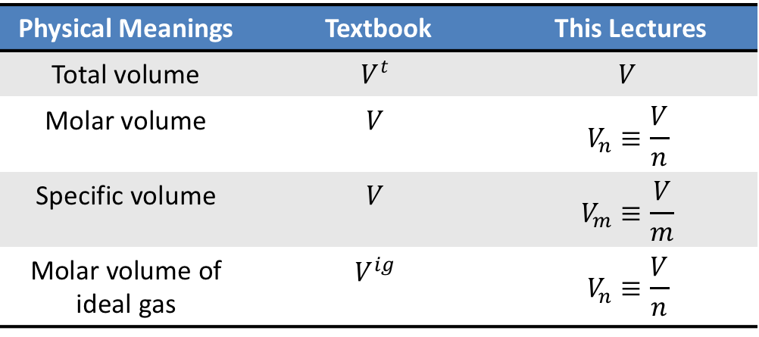
Symbols
Physical Meanings | Textbook | This Lectures
Total volume | $$V^{t}$$ | $$V$$
Molar volume | $$V$$ | $$V_{n}≡\frac{V}{n}$$
Specific volume | $$V$$ | $$V_{m}≡\frac{V}{m}$$
Molar volume of ideal gas | $$V^{ig}$$ | $$V_{n}≡\frac{V}{n}$$
All symbols of Capital Letters in textbook mean specific or molar properties

Slide 12
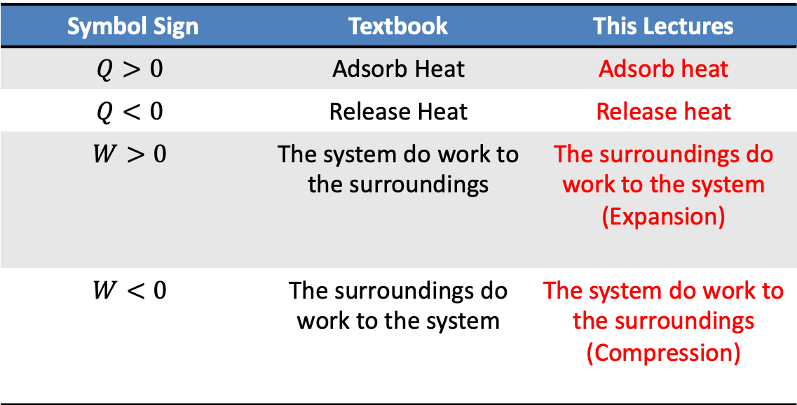
The Sign of Value
Symbol Sign | Textbook | This Lectures
$$Q>0$$ | Adsorb Heat | Adsorb heat
$$Q<0$$ | Release Heat | Release heat
$$W>0$$ | The system do work to the surroundings | The surroundings do work to the system (Expansion)
$$W<0$$ | The surroundings do work to the system | The system do work to the surroundings (Compression)

Slide 13
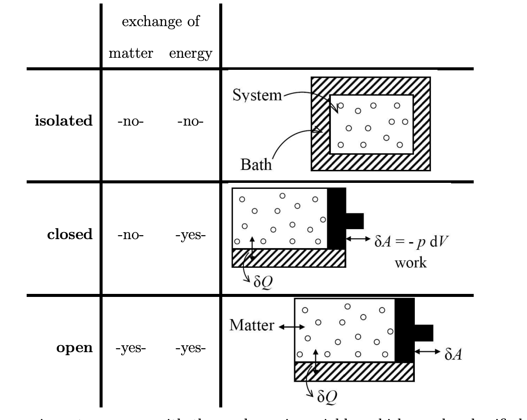
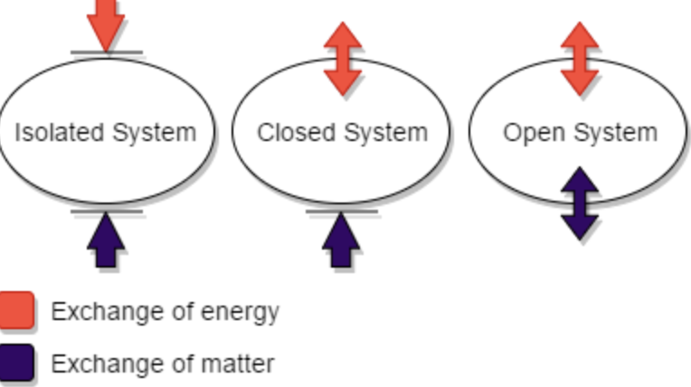
Systems
Closed system
Isolated system
Open system
Steady-flow system

Slide 14
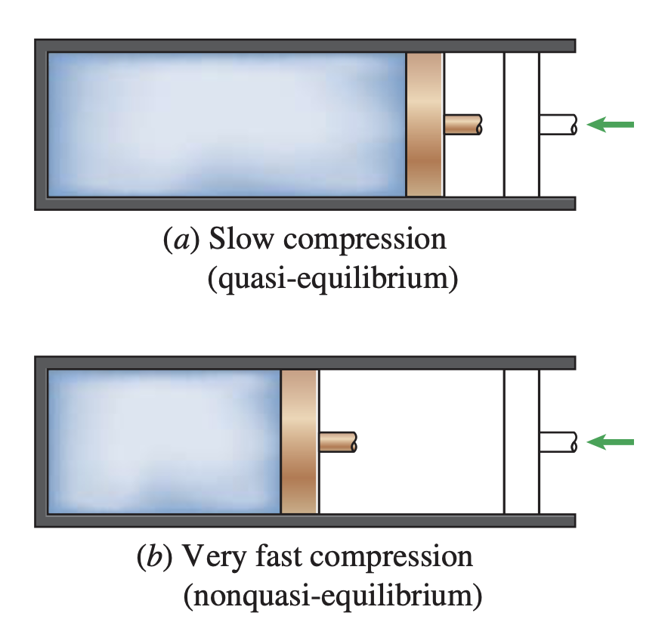
State and Process
Thermodynamic state
Equilibrium state
Thermodynamic process
Quasi-static process

Slide 15
Measures of Amount or Size
Intensive variables: independent of the size
Extensive variables: dependent of the size
Specific: V_{m}=V/m
Molar : V_{n}=V/n

Slide 16
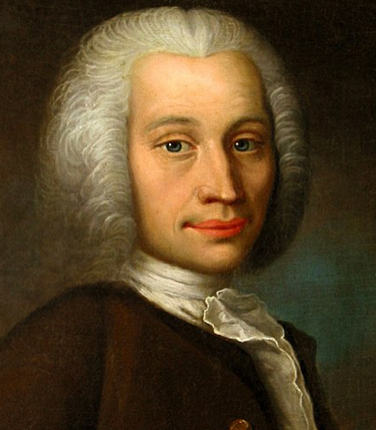
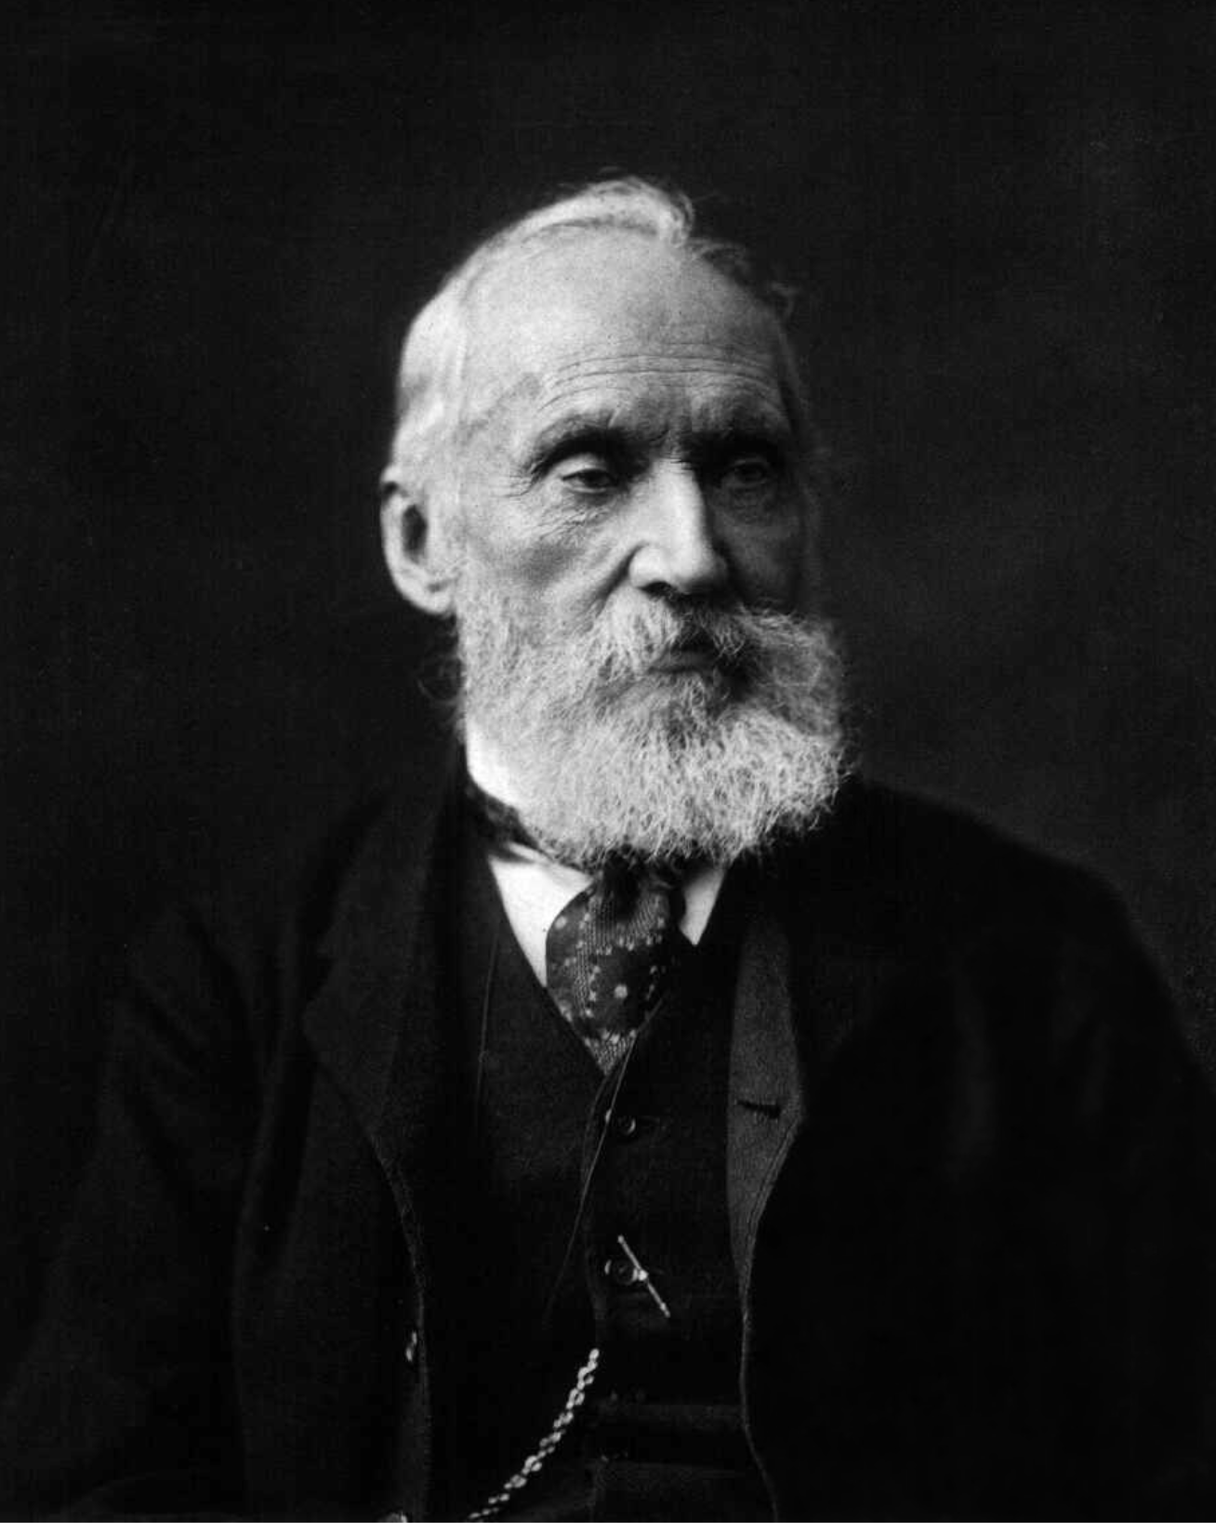
Temperature
Celsius scale
Kelvin scale
Anders Celsius
(1701-1744)
William Thomson
Lord Kelvin
(1824-1907)

Slide 17
Pressure
P=F/A
Pa, kPa, MPa, bar,
1 kPa = 10³ Pa
1 bar = 10⁵ Pa
1 Mpa = 10⁶ Pa

Slide 18
Energy (E)
Mechanical energy: kinetic energy, potential energy
Internal energy: all microscopic energy
Energy in transfer: heat, work

Slide 19
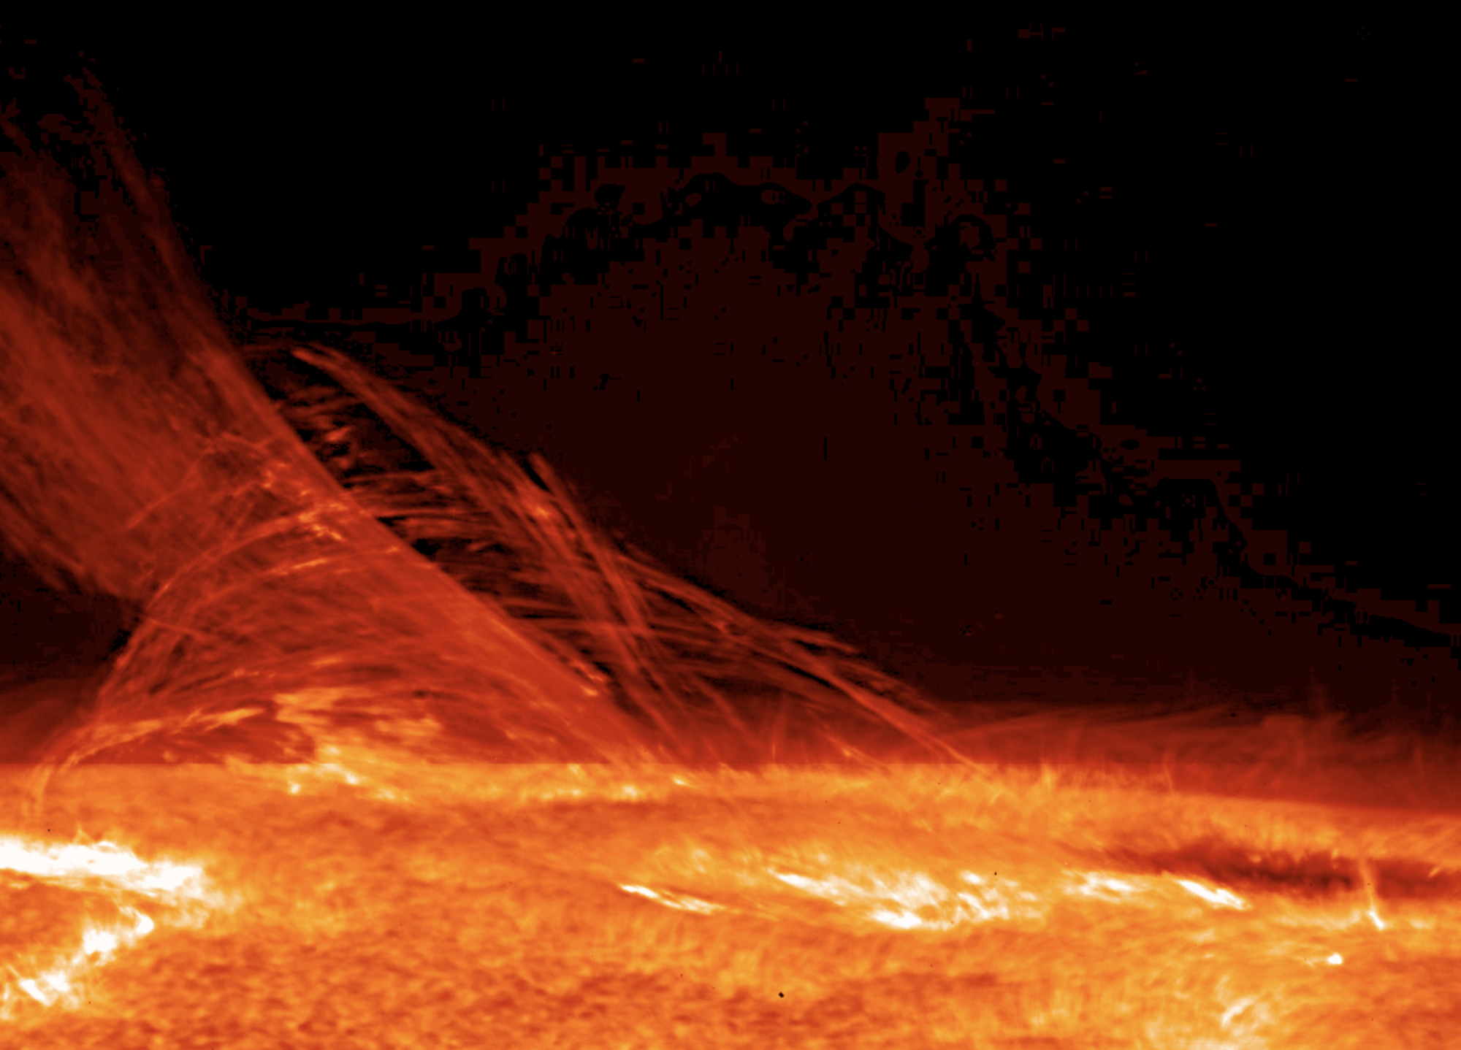
Heat (Q)
Heat, like work, is energy in transition

Slide 20
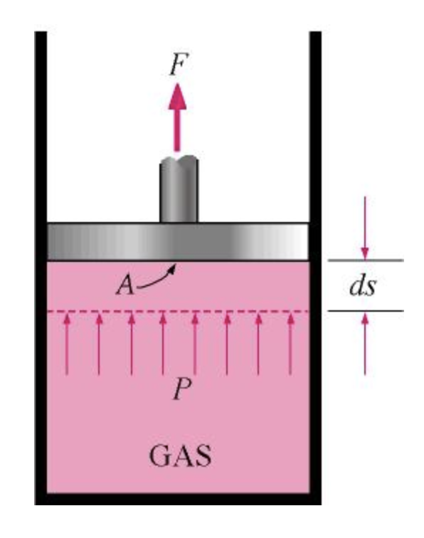
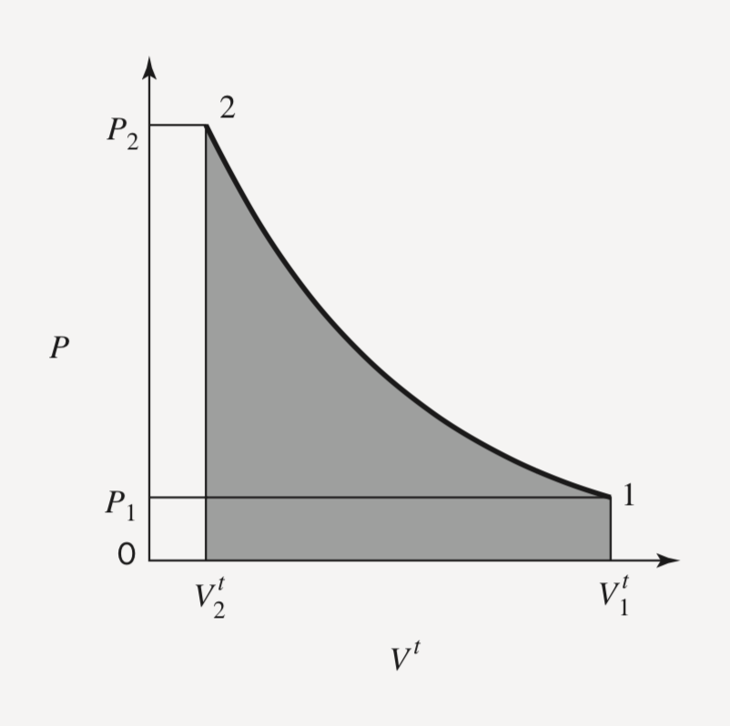

Work (W)
dW=Fdl
Moving boundary work
$$dW=Fdx=pAdx=pdV$$

Slide 21
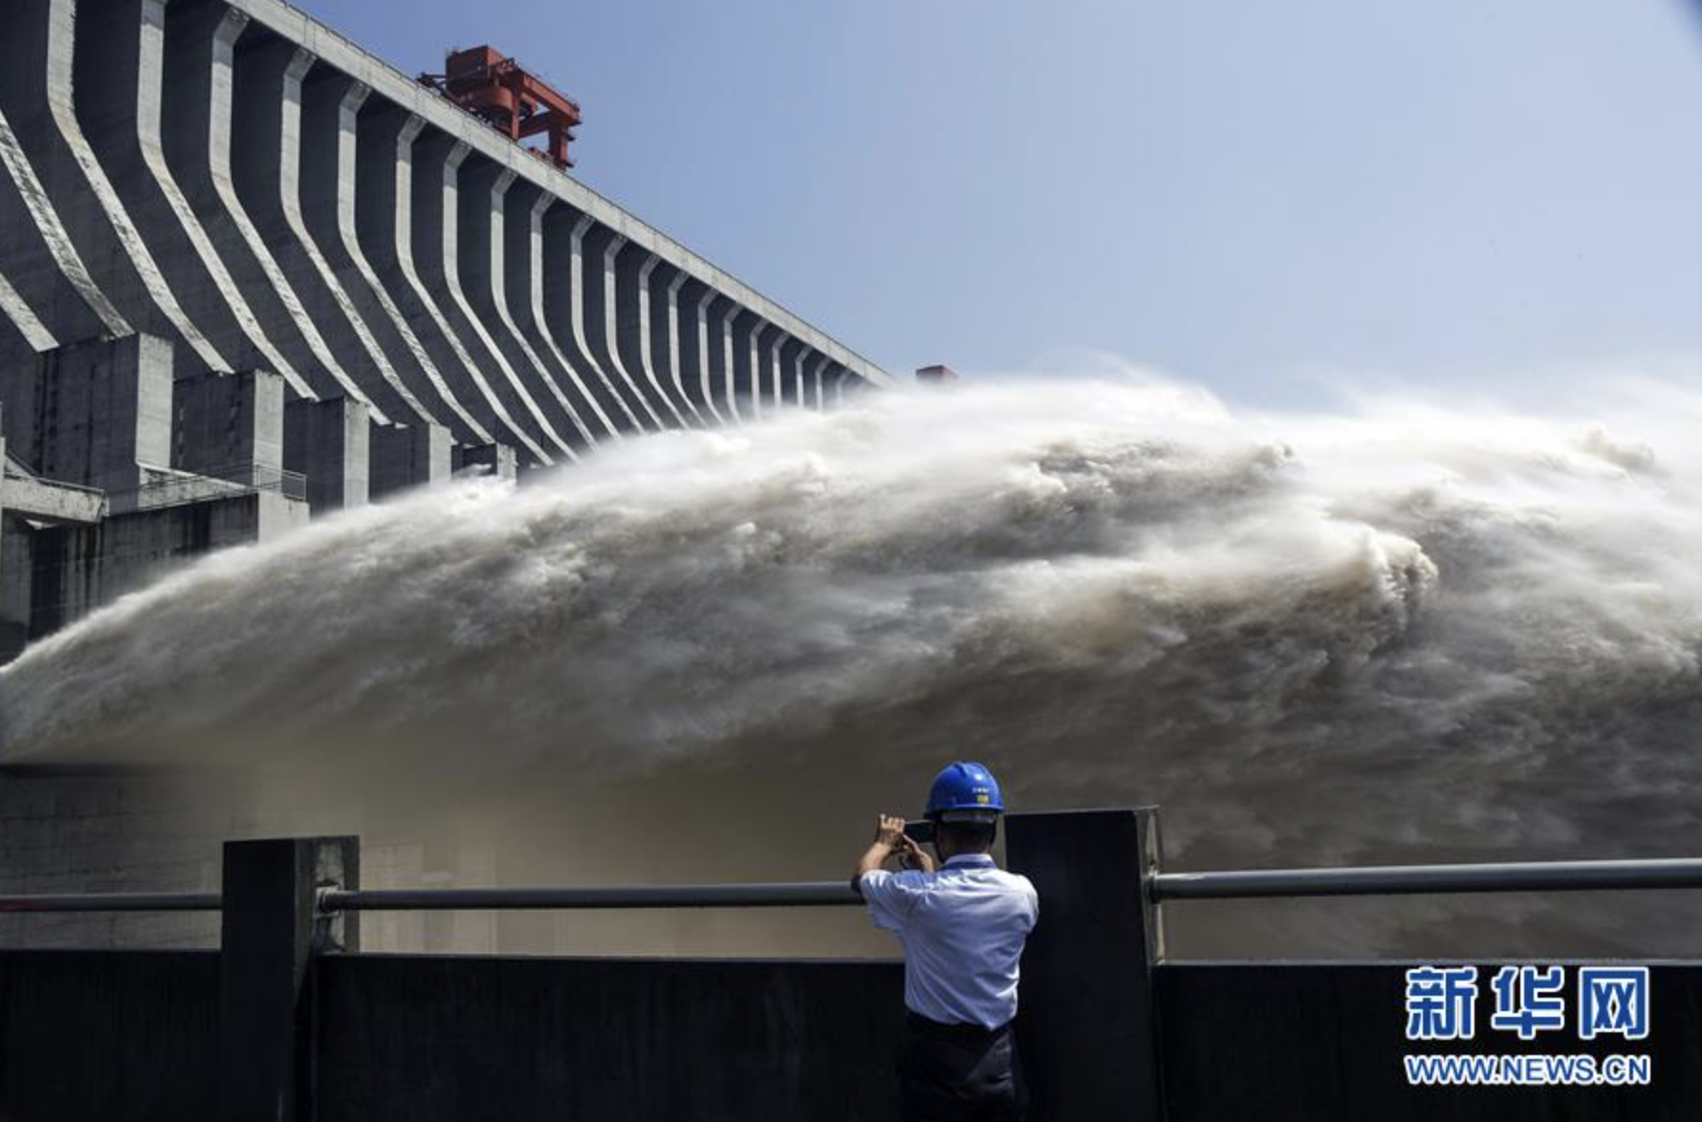
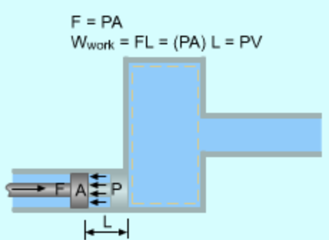

Work (W)
dW=Fdl
Flow work
$$dW=Fdx=pAdL=pdV$$

Slide 22
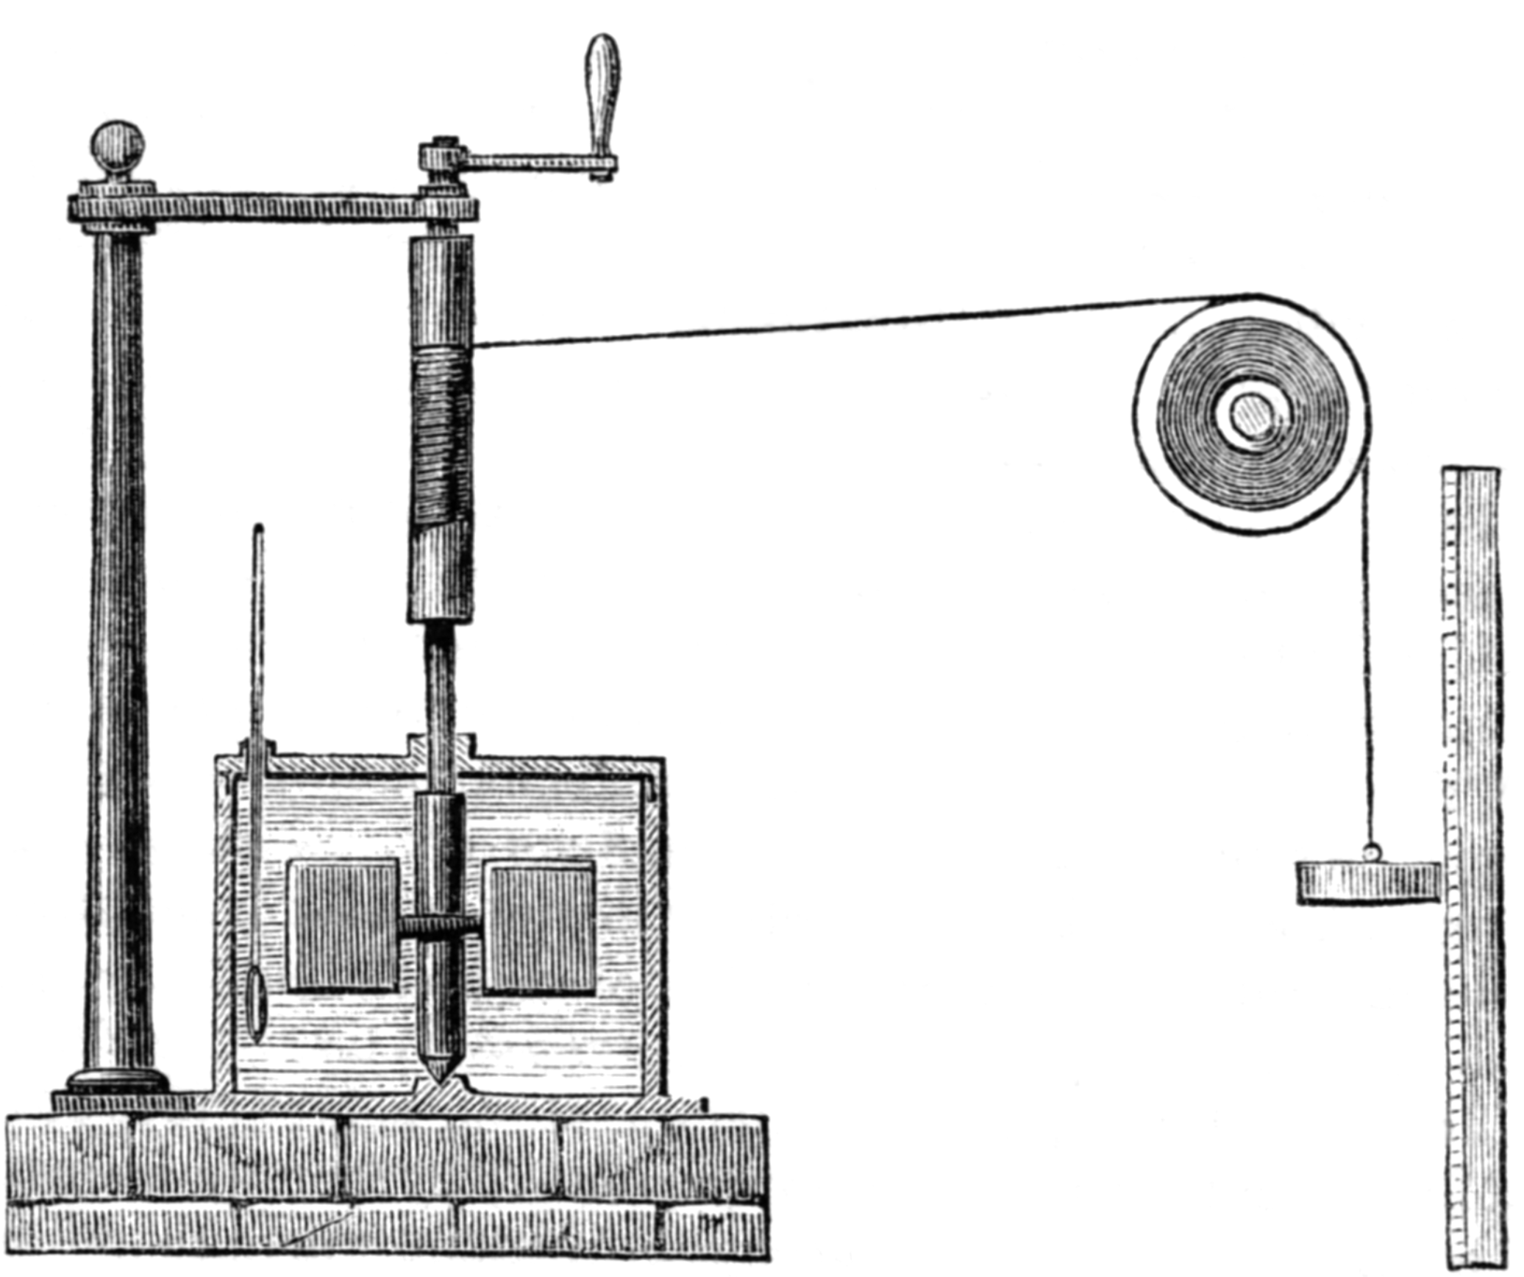
Joule’s Experiment
A quantitative relationship between work and heat
Heat is a form of energy

Slide 23
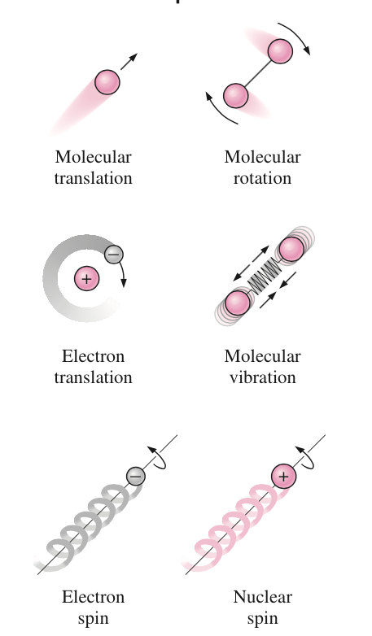
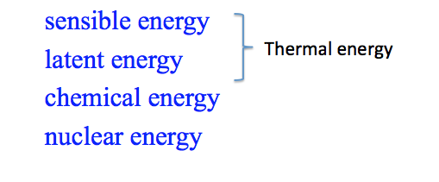
Internal Energy
The total energy of all microscopic forms

Slide 24
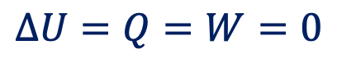



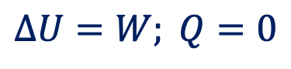

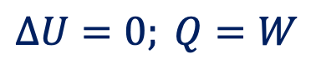
The First Law
Energy conservation
$$E=constant$$
Open system
$$ΔE_{sys}=ΔE_{surr}$$
Closed system
$$ΔE=Q−W$$
Stationary system
$$ΔU=Q−W$$
Isolated system
$$ΔU=Q=W=0$$
Cycle
$$ΔU=0; Q=W$$
Adiabatic process
$$ΔU=W; Q=0$$

Slide 25
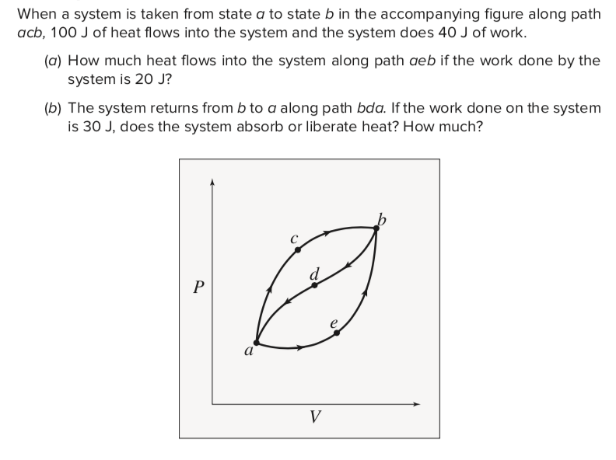
Example

Slide 26
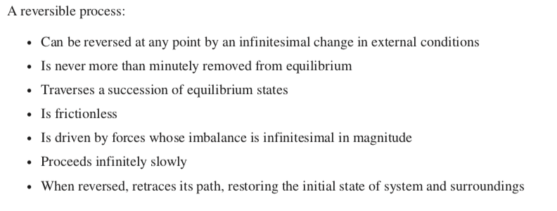
Reversible Process

Slide 27
Enthalpy
Reversible, isobaric, closed-system： d(U+PV)=dQ
Enthalpy: H=U+PV
Extensive
U: the energy required to create the system
PV: the work required to “make room” for the system

Slide 28
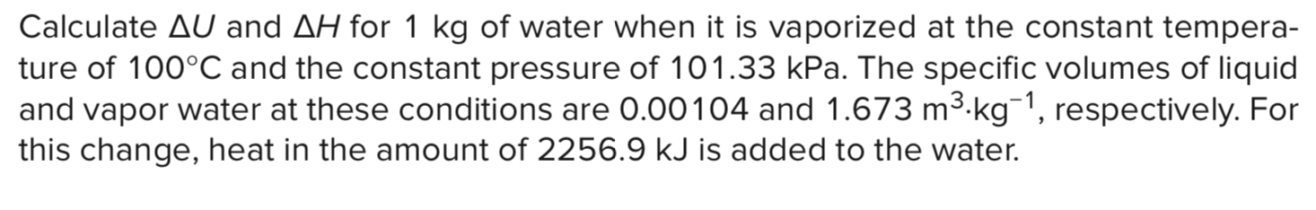
Example

Slide 29
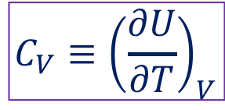
Heat Capacity at Constant Volume
$$C_{V}≡{\left(\frac{∂U}{∂T}\right)}_{V}$$
Extensive
Molar heat capacity (intensive)
Specific heat capacity (intensive)
The amount of energy to be supplied to a given mass of a material to produce a unit change in its temperature.
Unit: J/K; J/(kg.K)

Slide 30
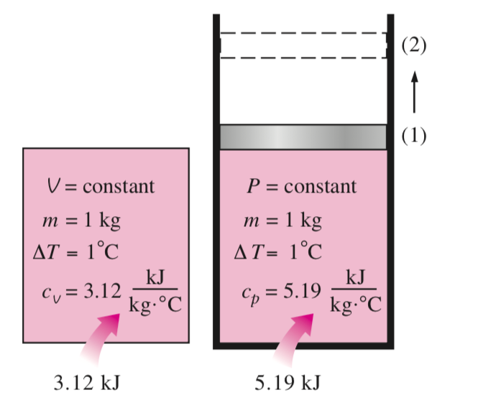
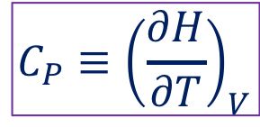
Heat Capacity at Constant Pressure
$$C_{P}≡{\left(\frac{∂H}{∂T}\right)}_{V}$$

Slide 31
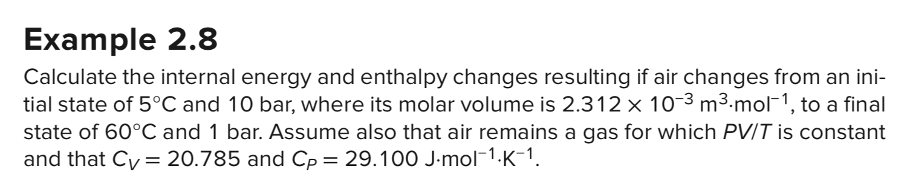
Example

Slide 32
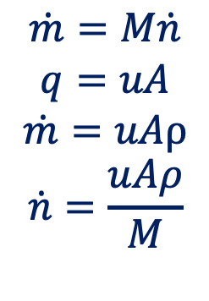
Measures of Flow
Mass flow rate
Molar flow rate
Volumetric flow rate
Velocity
$$\dot{m}=M\dot{n}$$
$$q=uA$$
$$\dot{m}=uAρ$$
$$\dot{n}=\frac{uAρ}{M}$$

Slide 33
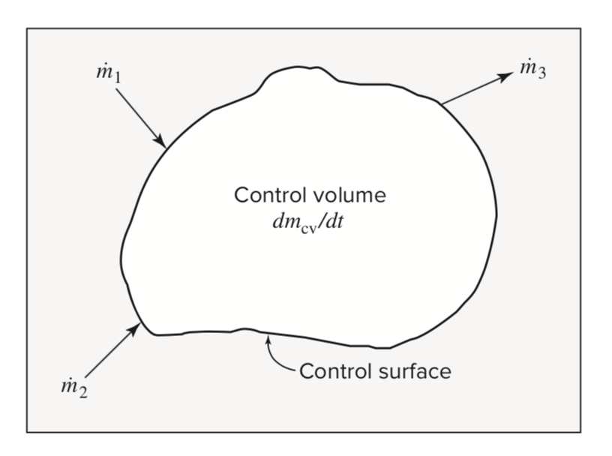
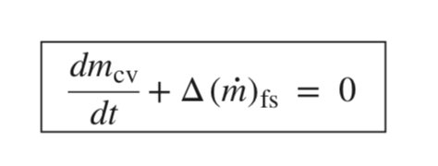
Mass Balance for Open Systems
Rate of change
Net rate of flow mass into the system

Slide 34
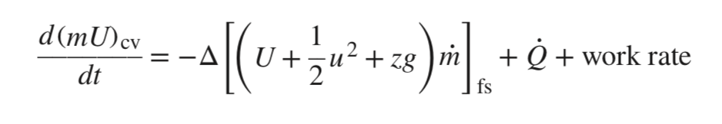
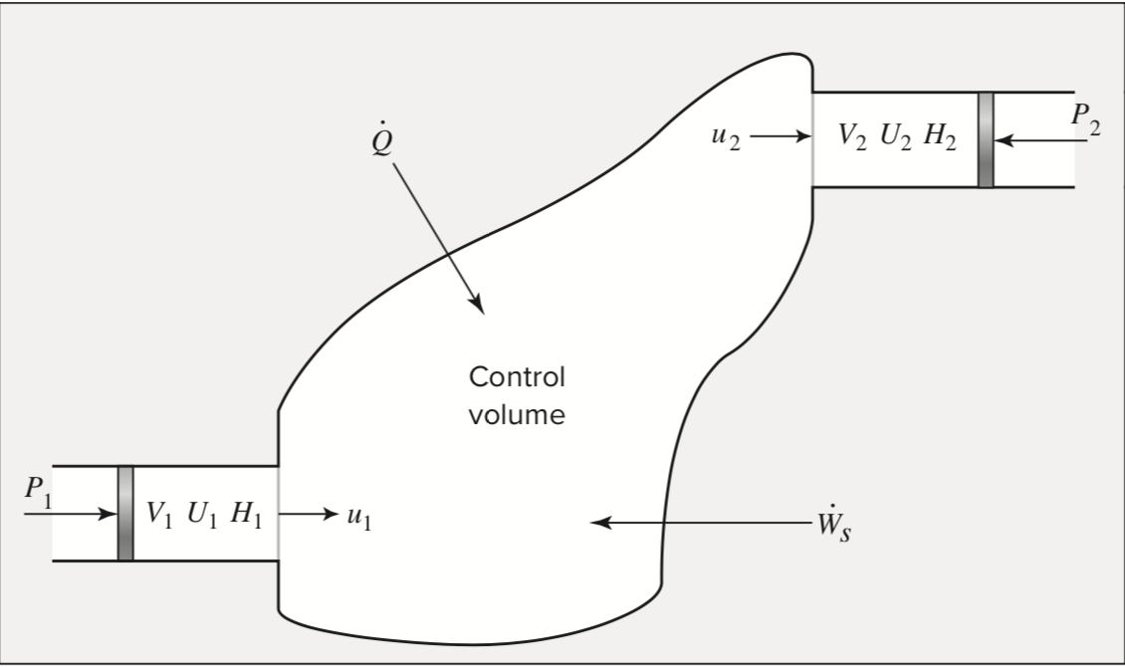
Energy Balance for Open Systems
Energy change rate
Internal energy
Kinetic energy
Potential energy
Flow mass rate
Heat
Work

Slide 35
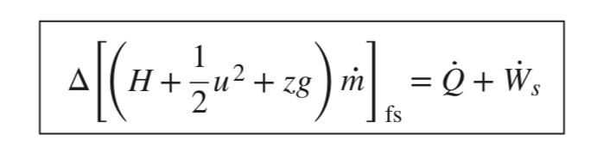
Energy Balances for Steady-State flow Processes

Slide 36
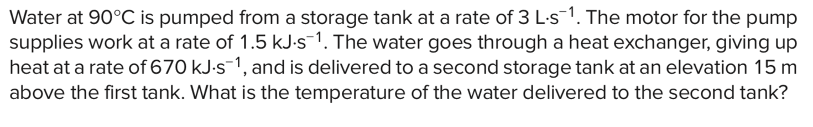
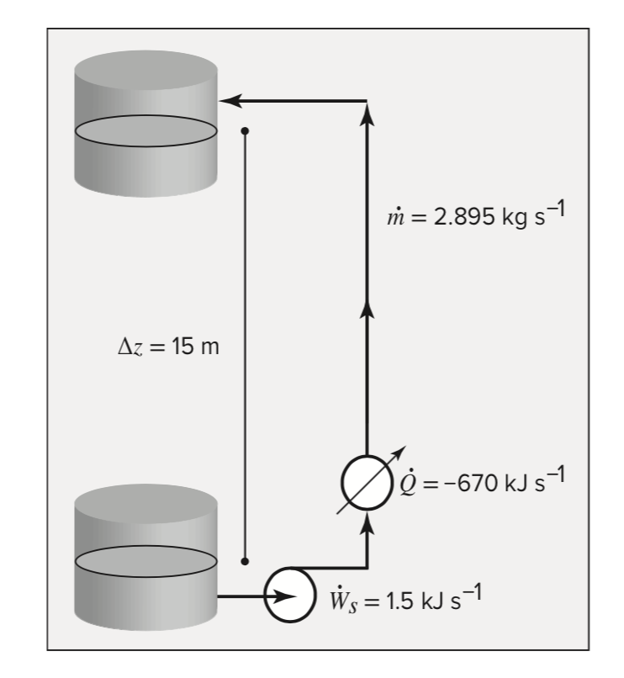
Example

Slide 37
Summary of Key Points
Intensive/Extensive
Internal energy
The First Law
Definition of enthalpy
Heat capacity
Mass and energy balances for steady-state flow process

